Slide 1
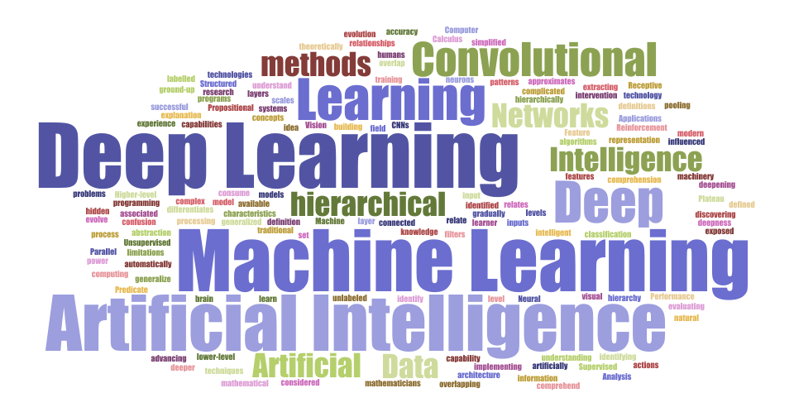
➻
CS4243 Project
⋅ Group 37⋅
➻
Nikita Goh Mei Xian
Ye Jiaying
Ethan Wong Goon Hong
Notes:
Hello everyone, and welcome to our presentation for our CS4243 Project. My name is Nikita, and along with my teammates Jiaying and Ethan, we will be sharing our individual contributions to this Deep Learning project.

Slide 2
⋅ Table of contents ⋅
⋅ 01 ⋅
⋅ 02 ⋅
⋅ 03 ⋅
Introduction
Data Collection
Implementation
⋅ 04 ⋅
⋅ 05 ⋅
⋅ 06 ⋅
Numerical Results
Improvements
Conclusion
Project Motivation and Aim
Web Scraper
MLP and CNN models
Graph Visualization
Adam Algorithm Optimizer
Notes:
Here is a brief overview, including an introduction to our project, our data collecting process, the implementation of our MLP and CNN machine learning models, an analysis of our numerical results, how we went about exploring improvements based on those results, and finally ending with a conclusion.

Slide 3
➻
⋅ 01 ⋅
Introduction
➻
Project Motivation & Aim
Manual sorting of items can be tedious and time-consuming
Simplify the process with type and brand classification algorithms
Further implementation with sorting machines to achieve automation
Notes:
Our project motivation and aim.
With some of our group members having previously worked in retail, we found it extremely tedious and time-consuming to sort through items manually, and this problem will only grow as the number of items lining our store shelves increases. Thus, we were inspired to simplify this process using type and brand classification algorithms. Once these algorithms has been refined, further implementation with sorting machines could help us achieve automation.

Slide 4
➻
⋅ 02 ⋅
Data Collection
Selenium Web Scraper
Open Google image search page with given query
Download all images
Delete images that do not fit our query
Transform images into tensors
Notes:
Data collection.
All images we used during our training and testing process were gathered from Google Images. To expedite this process, we created a web scraper using the Selenium library. To give a basic idea of how this was done, we first opened a google image search page with selenium and gave it our specified query. After that, our program will download all images present on the webpage. To clean our data, we then manually went through the images and deleted any that don’t fit what we want, some examples of that will be given later. And finally, we transform each image into pytorch tensors.

Slide 5
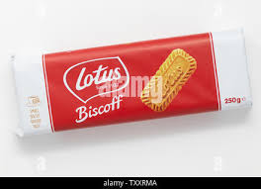
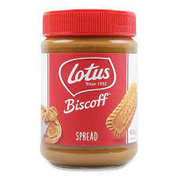
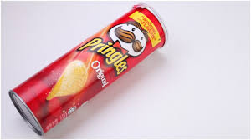
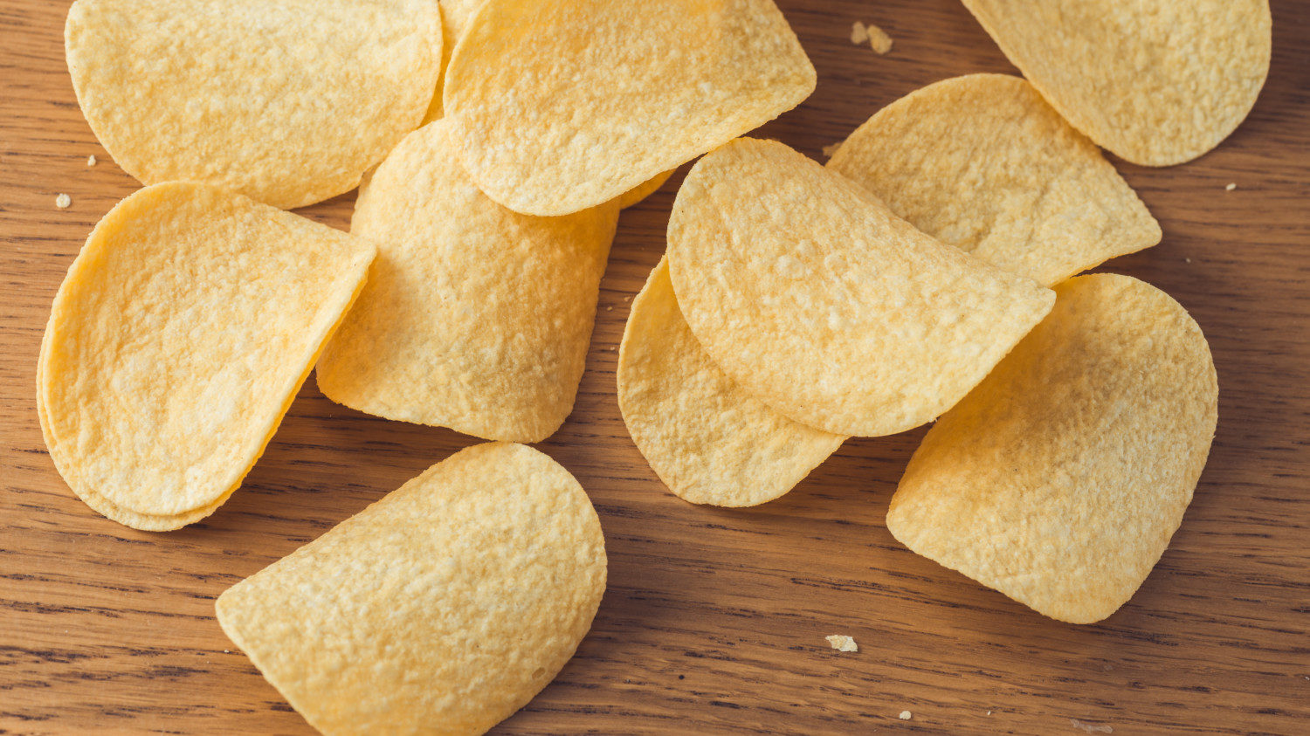
⋅ Some examples ⋅
Lotus
Pringles
Accepted!
Rejected
Accepted!
Rejected
Notes:
Here are some examples of how we went about cleaning our data.
On the left, although both are Lotus products, we wanted lotus biscoff biscuits, and thus rejected the image of the lotus biscoff spread.
On the right, although both images are technically pringles potato chips, our algorithm aims to classify products based on their packaging, and thus we reject the image of the package-less chips.

Slide 6
➻
⋅ 03 ⋅
Implementation
➻
Data set:
7 : 3 ratio of training set and test set
MLP:
Brand classification
Type classification
CNN:
Brand classification
Type classification
Notes:
For the implementation, we first sort the data set into a ratio of 7:3 for the training set and test set respectively.
For each of the MLP and CNN model, we will do a brand classification and type classification of the data set.

Slide 7
⋅ MLP Model ⋅
⋅ 01 ⋅
⋅ 02 ⋅
⋅ 03 ⋅
3-layer MLP network
Parameters
Training loop
Batchsize = 50
Learning rate = 0.01
Epoch = 50
Notes:
We used a MLP model with 3 layers, with the parameters of batchsize set to 50 and learning rate set to 0.01. The model was trained over 50 epochs.

Slide 8
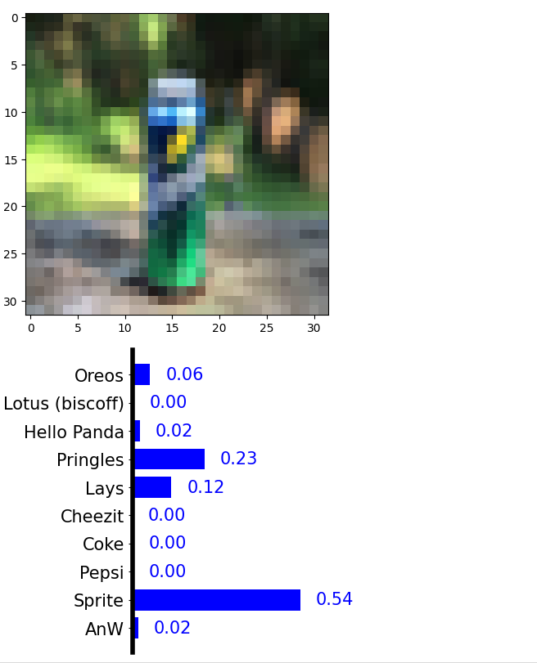
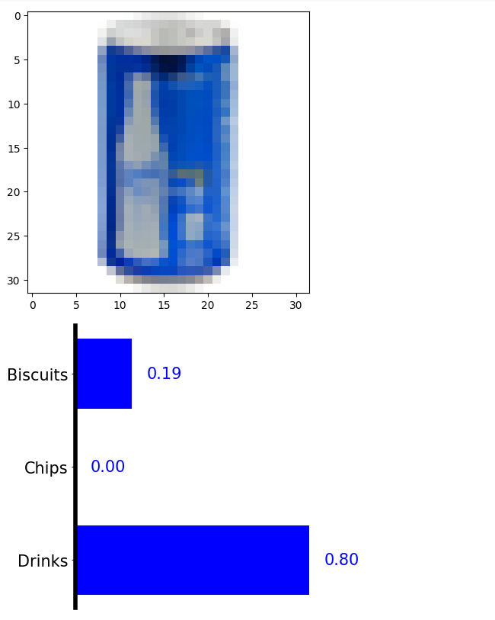
⋅ MLP Model ⋅
Sprite
Drinks
(Pepsi)
⋅ 04 ⋅
Random Image Test
Brands
Product type
Notes:
After the training was done, we selected an image at random to test, and the probability scores for the brands and type classifications are shown here respectively. However, the network does not give a good confidence score to the correct class.

Slide 9
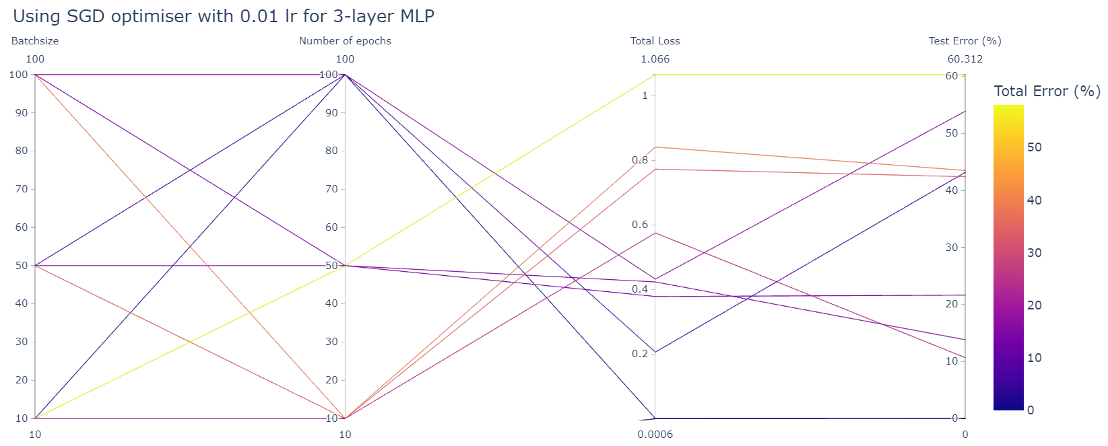
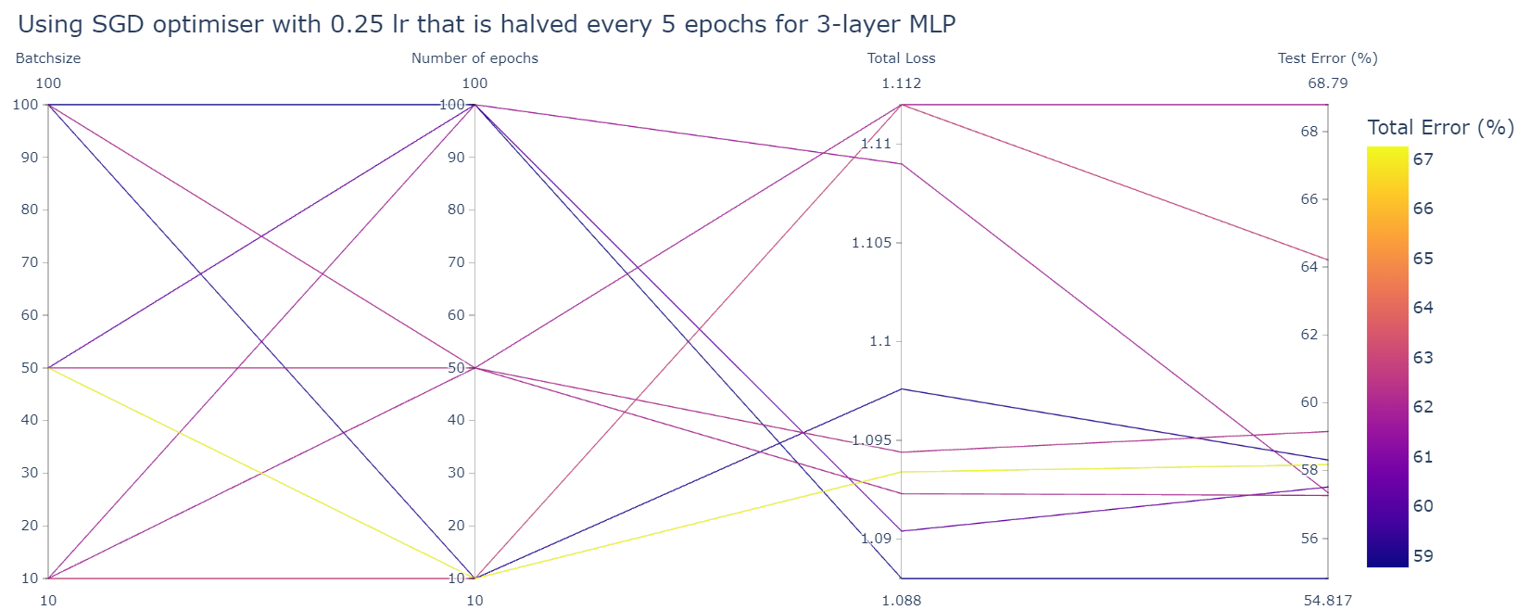
Hyperparameters optimization for MLP
Learning rate: 0.01
Batchsize: 10, 50, 100
Number of epochs: 10, 50, 100
Larger batch size and higher number of epochs lead to lower loss and error
Smaller batch size and lower number of epochs lead to higher loss and error
Learning rate: 0.25, halved every 5 epochs
Batchsize: 10, 50, 100
Number of epochs: 10, 50, 100
Same relationship but weaker correlation
Possibly due to higher learning rate that requires higher number of epochs to decay until optimal
Notes:
From there, we decided to explore the relationship between the hyperparameters, including the learning rate, batchsize, and number of epochs and the total loss, test error and total error. This is to find the optimal combination of hyperparameters to improve.
We decided to have a fixed learning rate of 0.01 and a learning rate schedule that started at 0.25 and halved every 5 iterations. For both sets of learning rates, the batchsize and number of epochs were set to 10, 50 and 100.
For the fixed learning rate, it was observed that larger batch size and higher number of epochs lead to lower loss and error, whereas smaller batchsize and lower number of epochs lead to higher loss and error.
For the learning rate schedule, the same relationship was observed but with weaker correlation. This is possibly due to the higher starting learning rate which requires a higher number of epochs to decay until optimal.

Slide 10
⋅ CNN Model ⋅
⋅ 01 ⋅
⋅ 02 ⋅
⋅ 03 ⋅
CNN Network
Parameters
Training loop
4 convolutional layers
2 linear layers
Batchsize = 50
Learning rate = 0.25
Epoch = 50
Notes:
As you can see, for the CNN model, we decided to use a CNN network with 4 convolutional layers and 2 linear layers where the size of each layer was predetermined, except for the output size, which would be taken in as an input parameter so that the model can be replicated for use with other data sets.
We decided to set, the batchsize to be 50 which is the same as the MLP models, and the learning rate to be 0.25 which would be divided by 2 every 5 epochs. We then trained the model for 50 epochs.

Slide 11
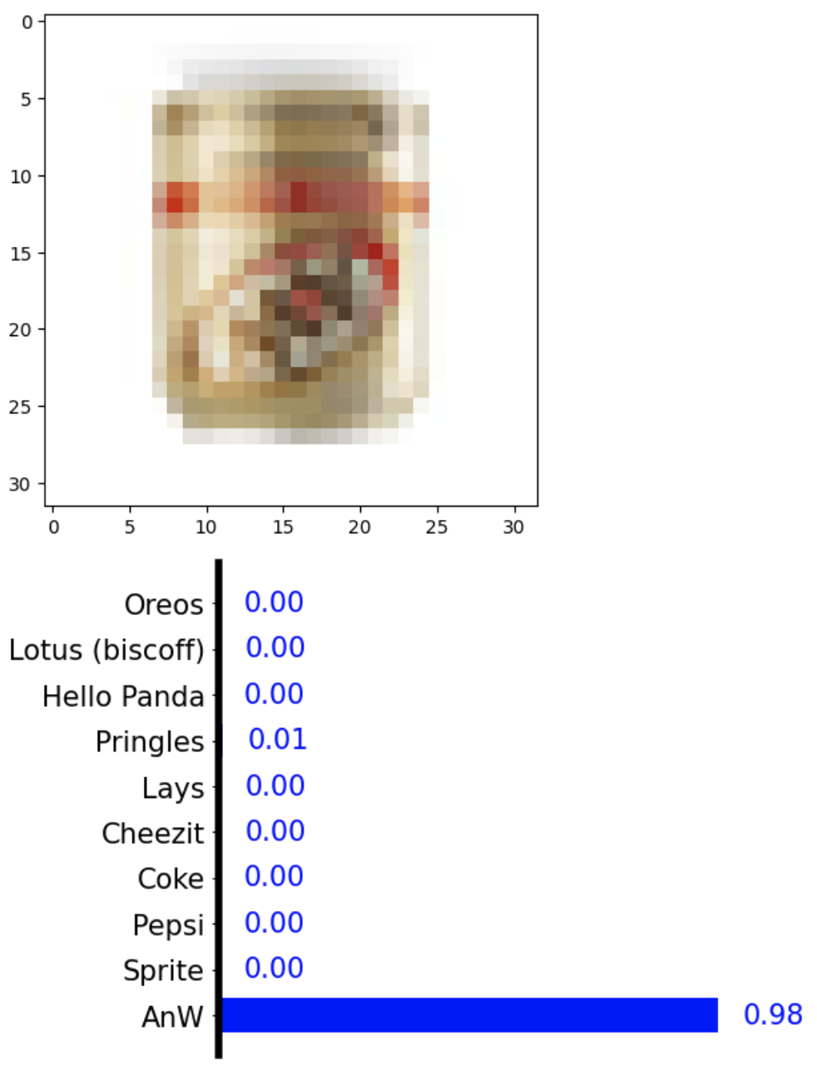
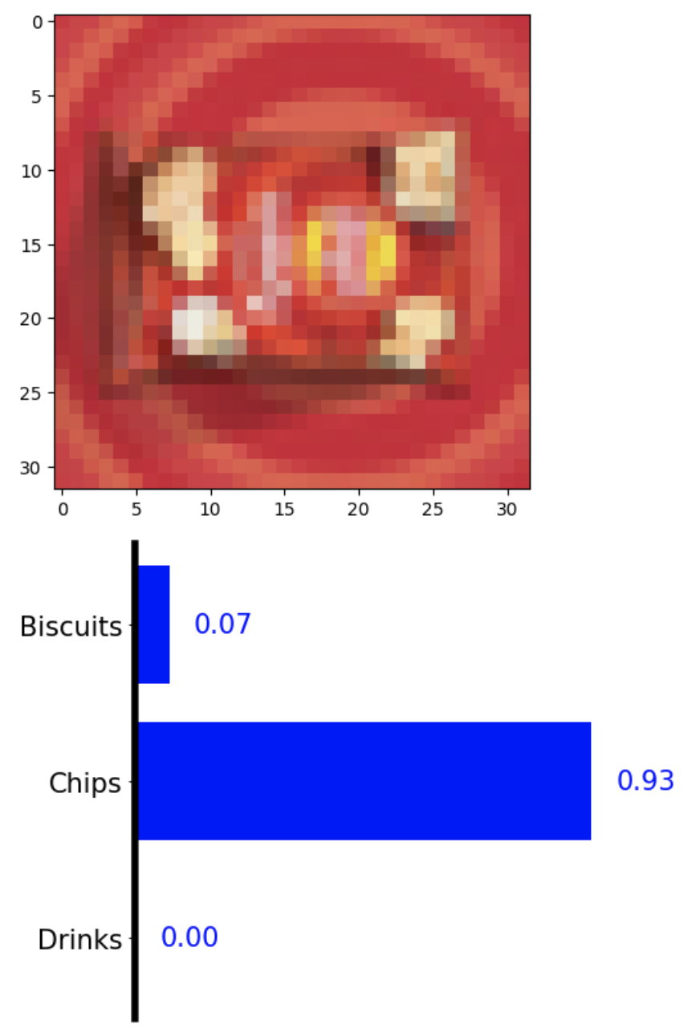
⋅ CNN Model ⋅
AnW
Chips
(Lays)
⋅ 04 ⋅
Random Image Test
Brands
Product type
Notes:
After training is done, we can do a random image test, and here you can see the probability of scores for the brand and type classification respectively, which are much higher than the MLP’s scores.

Slide 12
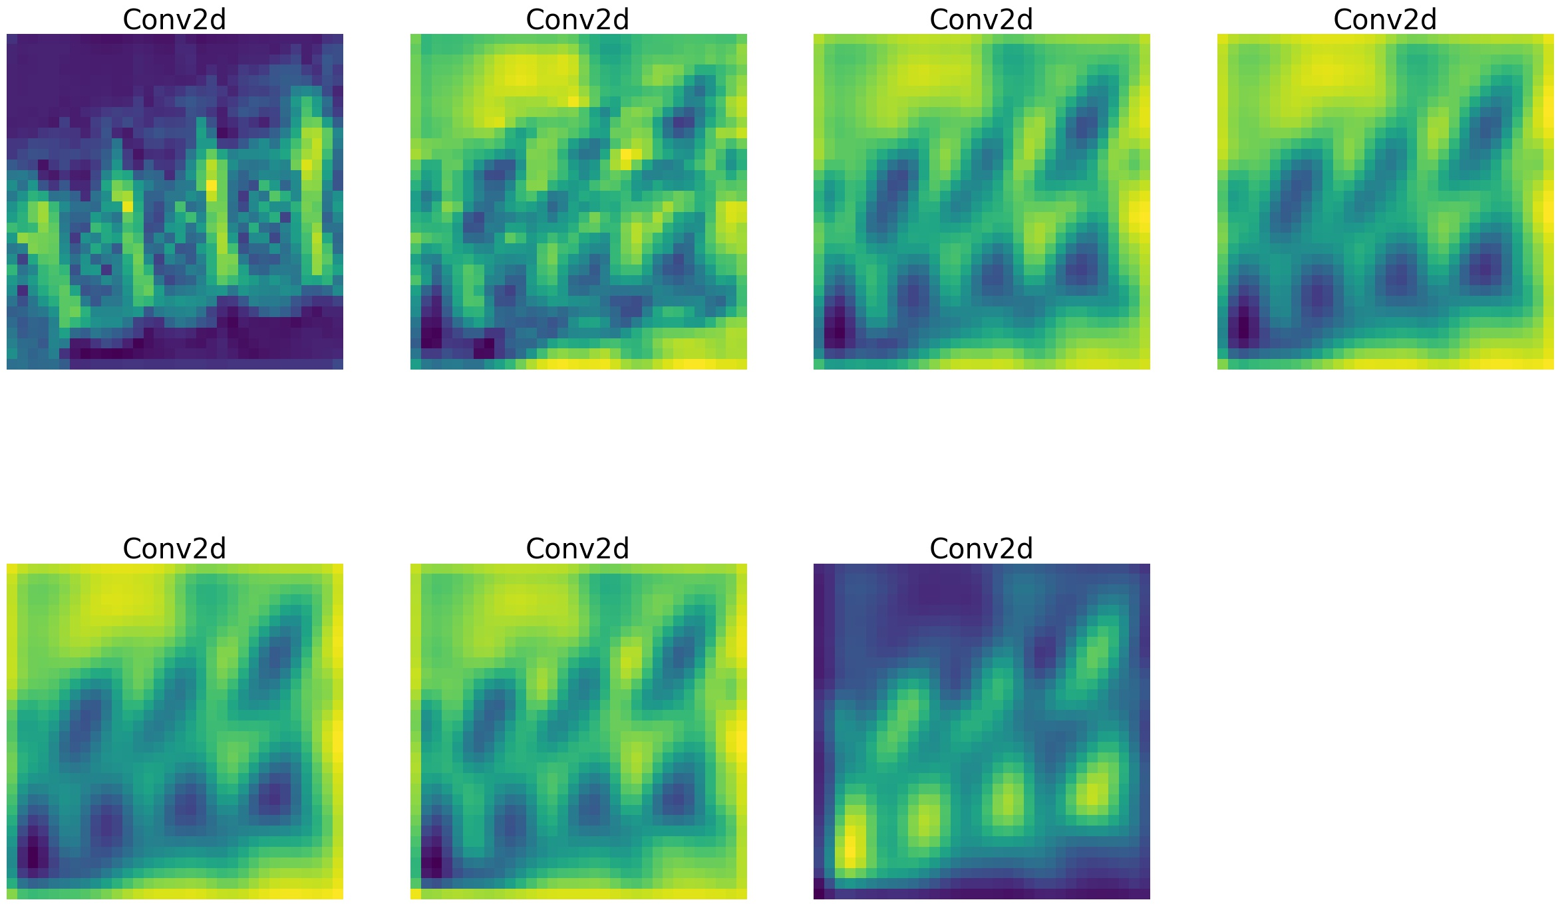
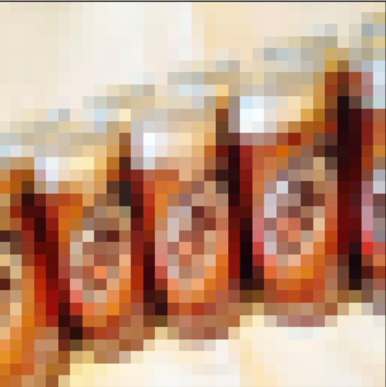
Feature map visualization
conv4a
conv3b
conv3a
conv2b
Images selected from test set randomly for both Brand and Product Type classification
Feature maps of the filters learnt with the respective CNN models were visualized
Shows that the CNN models learn hierarchical filters: the deeper the layer, the more details there are
conv2a
conv1b
conv1a
Test set image:
AnW
Notes:
We decided to visualize the feature maps to understand how our CNN model was working. For each class in brand and type, at the end of the training loop, an image was selected from the test set randomly. It is passed through the CNN filters that were extracted. The visualization shows that our CNN model learns hierarchical filters as the deeper the layer, the more details there are, as shown in the example of AnW and its feature maps.

Slide 13
➻
⋅ 04 ⋅
Numerical Results
Training Parameters
Batch Size = 50
Epoch = 50
Size of Training Set = 3318
Size of Test Set = 1422
Notes:
Now to analyse the numerical results, as stated earlier, we have tried to set the training parameters of both models to be similar to each other, with a batch size of 50, training loop of 50 epochs and using the same training set and test set.

Slide 14
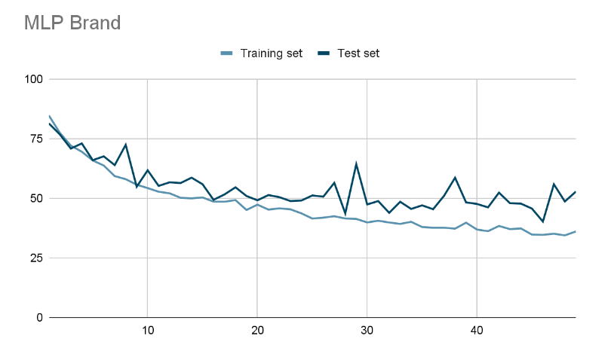
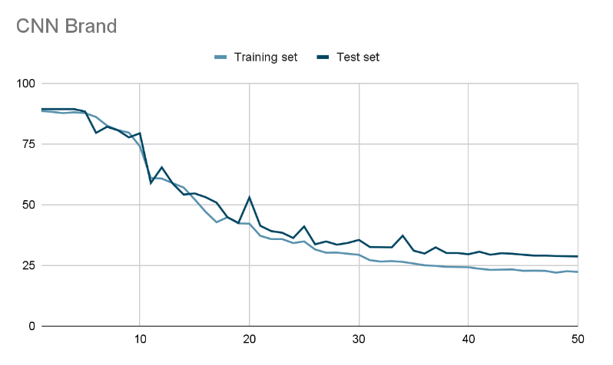
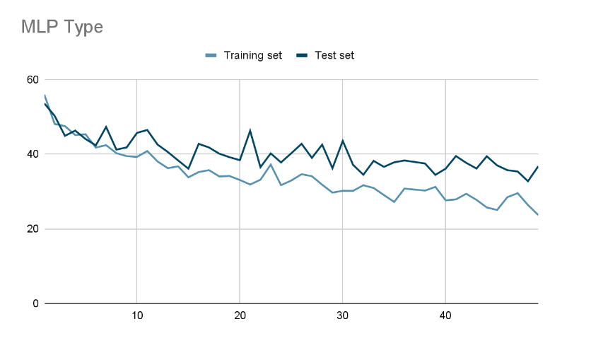
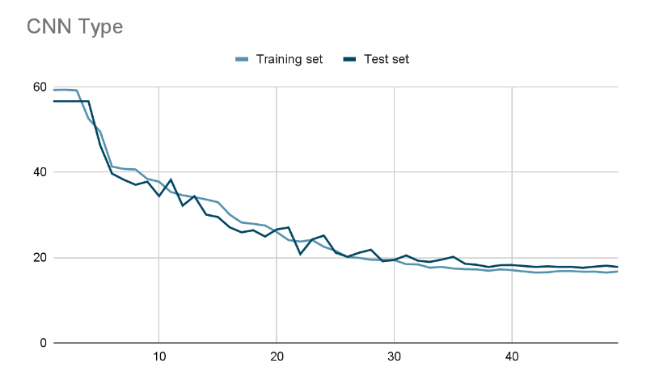
· Graph Visualisation ·
Notes:
Here are the graphs of the error rate of the two types of classification for each model.

Slide 15
· Results Interpretation ·
Error rate on Training Set (MLP & CNN):
Stable decrease
Error rate on Test Set (MLP):
Large fluctuations
Higher final error rate (~50%)
Error rate on Test Set (CNN):
Similar curve with training set
Lower final error rate (~25 %)
Notes:
Comparing the two models, the error rate on most of the training sets for the two models have a relatively stable decrease.
However, it can be observed for the MLP model, there are comparatively much larger fluctuations for the test sets.
Finally, for the CNN model, the error rate curves of both the test set and training set are much more similar and it also achieve a much lower final error rate than the MLP model.
For example, for the brand classification, the CNN model has a lower final error rate of approximately 25% while the MLP model has a higher final error rate of around 50% for the test sets.

Slide 16
· Results Interpretation ·
SGD caused the heavy fluctuation
Frequent, high variance updates
Small data set
Frequency of each feature of an object is irregular
Tried using Adam Optimizer for our next iteration
Notes:
The reason for the large fluctuations was due to the use of the SGD optimizer in both models, which has frequent, high variance updates.
Furthermore, since we have a relatively small data set with an irregular frequency of each feature of object, the use of SGD optimizer results in our MLP and CNN model to reach an appropriate level of accuracy extremely slowly when the same learning rate is applied to all features.
Therefore, to improve our algorithm, we decided to try using the Adam algorithm optimizer, which uses adaptive learning rates for each network parameter.

Slide 17
➻
⋅ 05 ⋅
Improvements
➻
Adam Algorithm Optimizer:
Static learning rate of 0.001
Notes:
After seeing the results of our first iteration of neural networks, we decided to only work on improving the CNNs as they showed more potential.
The main change we made in this iteration was the use of the adam algorithm optimizer instead of the SGD optimizer. We experimented with various learning rates, but found learning rates that were too high would cause the network to stay stagnant across many epochs. In the end, we found a static learning rate of 0.001 to be most effective.

Slide 18
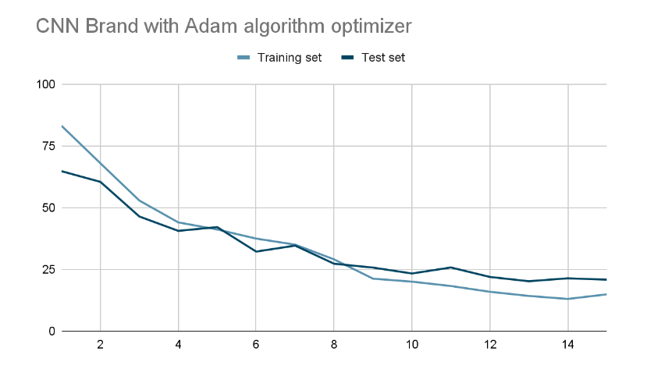
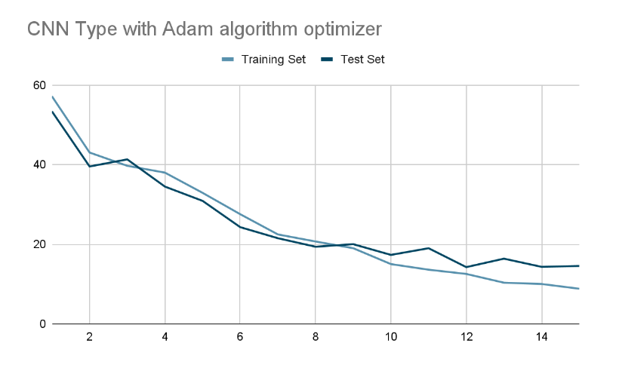
· Graph Visualisation ·
Smoother learning curve
Shorter training time
Notes:
With the same batch size, training set, and test set, these were the results we received after running only 15 epochs. As we can see, the error rates for both the training set and test set decrease at a smoother rate, and it only took 15 epochs to surpass the previous CNNs’ accuracy, even though they were trained for almost 3 times longer.

Slide 19
➻
⋅ 06 ⋅
Conclusion
Initial aim: Achieved!
Notes:
In conclusion, our team can confidently say we’ve achieved our initial goals of creating an algorithm to classify different products.

Slide 20
· Key Takeaways ·
CNN > MLP (in this scenario)
Greater flexibility for position & orientation
Adam optimizer more efficient than SGD optimizer
Adaptive learning rate vs Equal learning rate for each parameter
Future improvements:
Object segmentation:
Classify multiple objects in the same image to improve efficiency
Notes:
To list the key takeaways our team has learned from working on this project.
We found CNN to be a much better suit for this scenario when compared to MLP because of its greater flexibility when it comes to the position and orientation of the target object in the image.
Next, we found that the adam optimizer proved to be more efficient than the SGD optimizer due to the Adam optimizer’s adaptive learning rate.
As for possible future improvements, we would suggest implementing object segmentation using algorithms such as R-CNN. In doing so, the network would be able to classify multiple objects appearing in the same image, greatly increasing its efficiency.

Slide 21
⋅ Thank you! ⋅
End of presentation
Notes:
And with that, we’ve come to the end of our presentation, thank you for listening!

